Slide 1
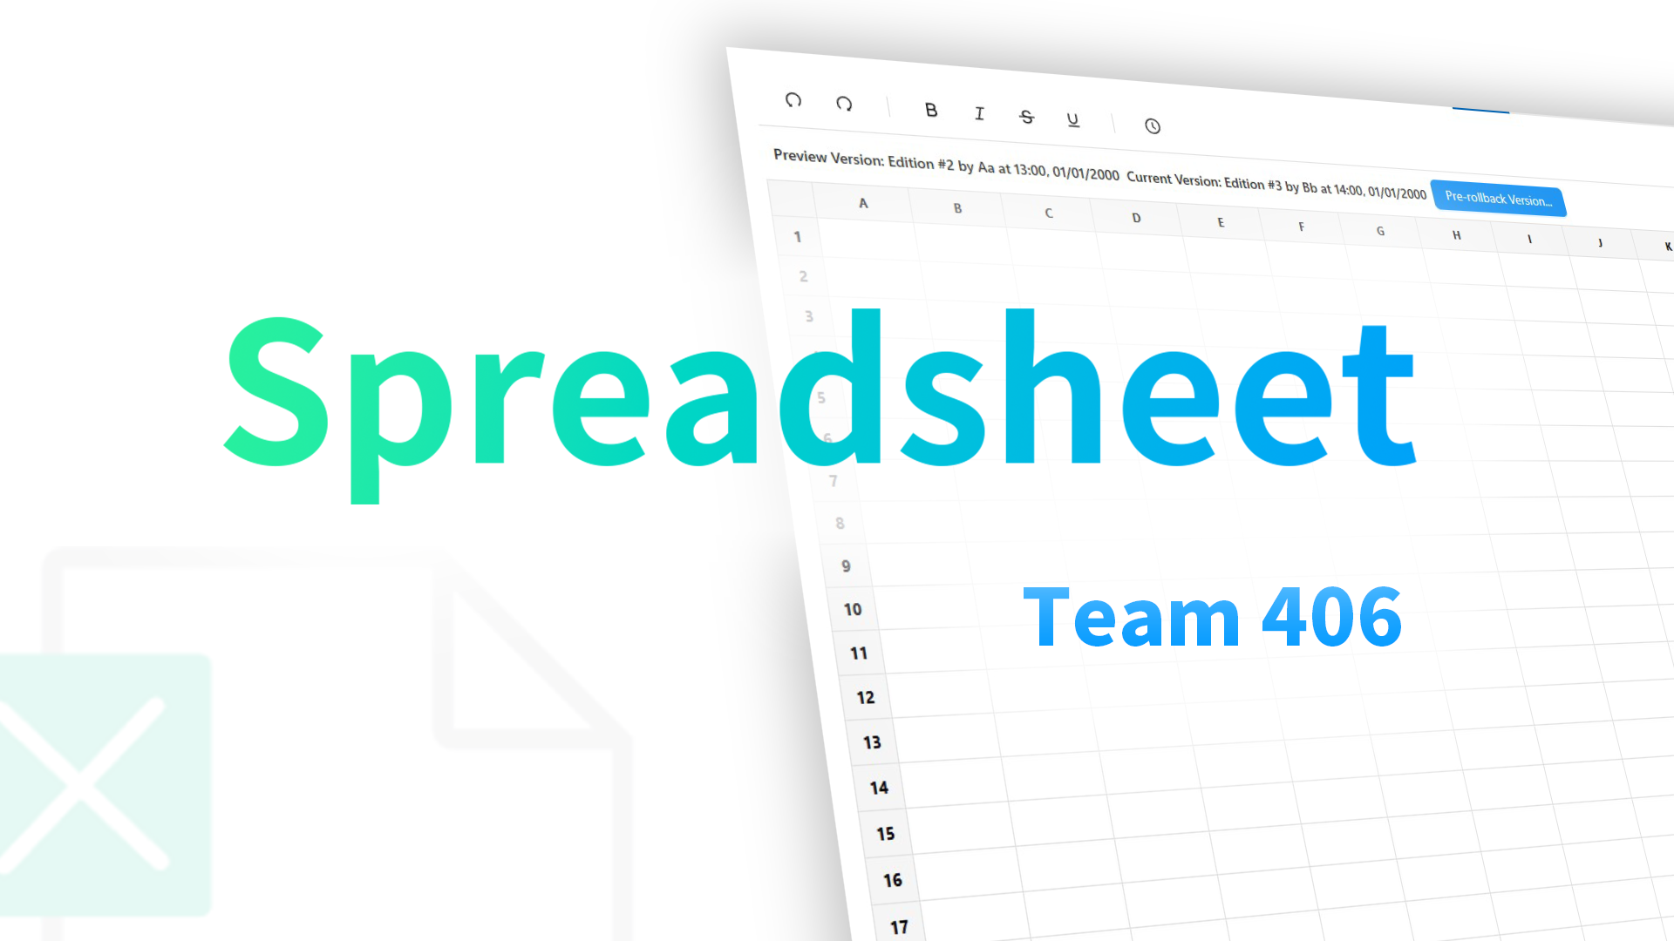
Notes:
Ganesh

Slide 2

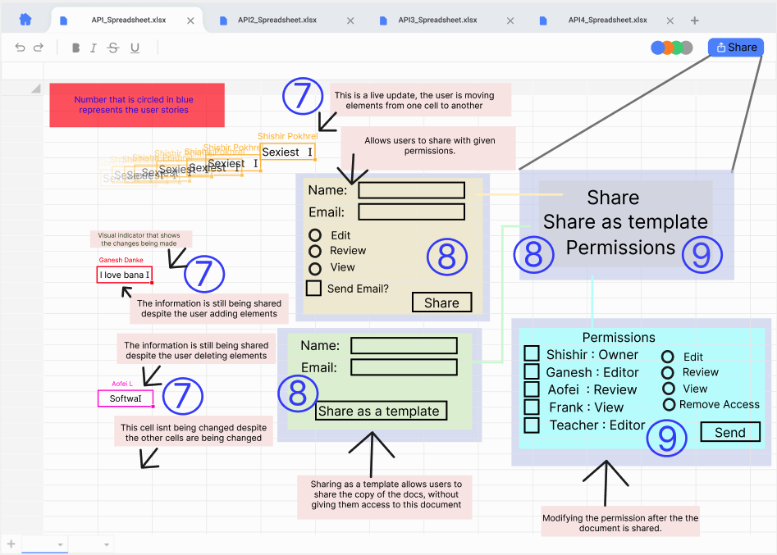
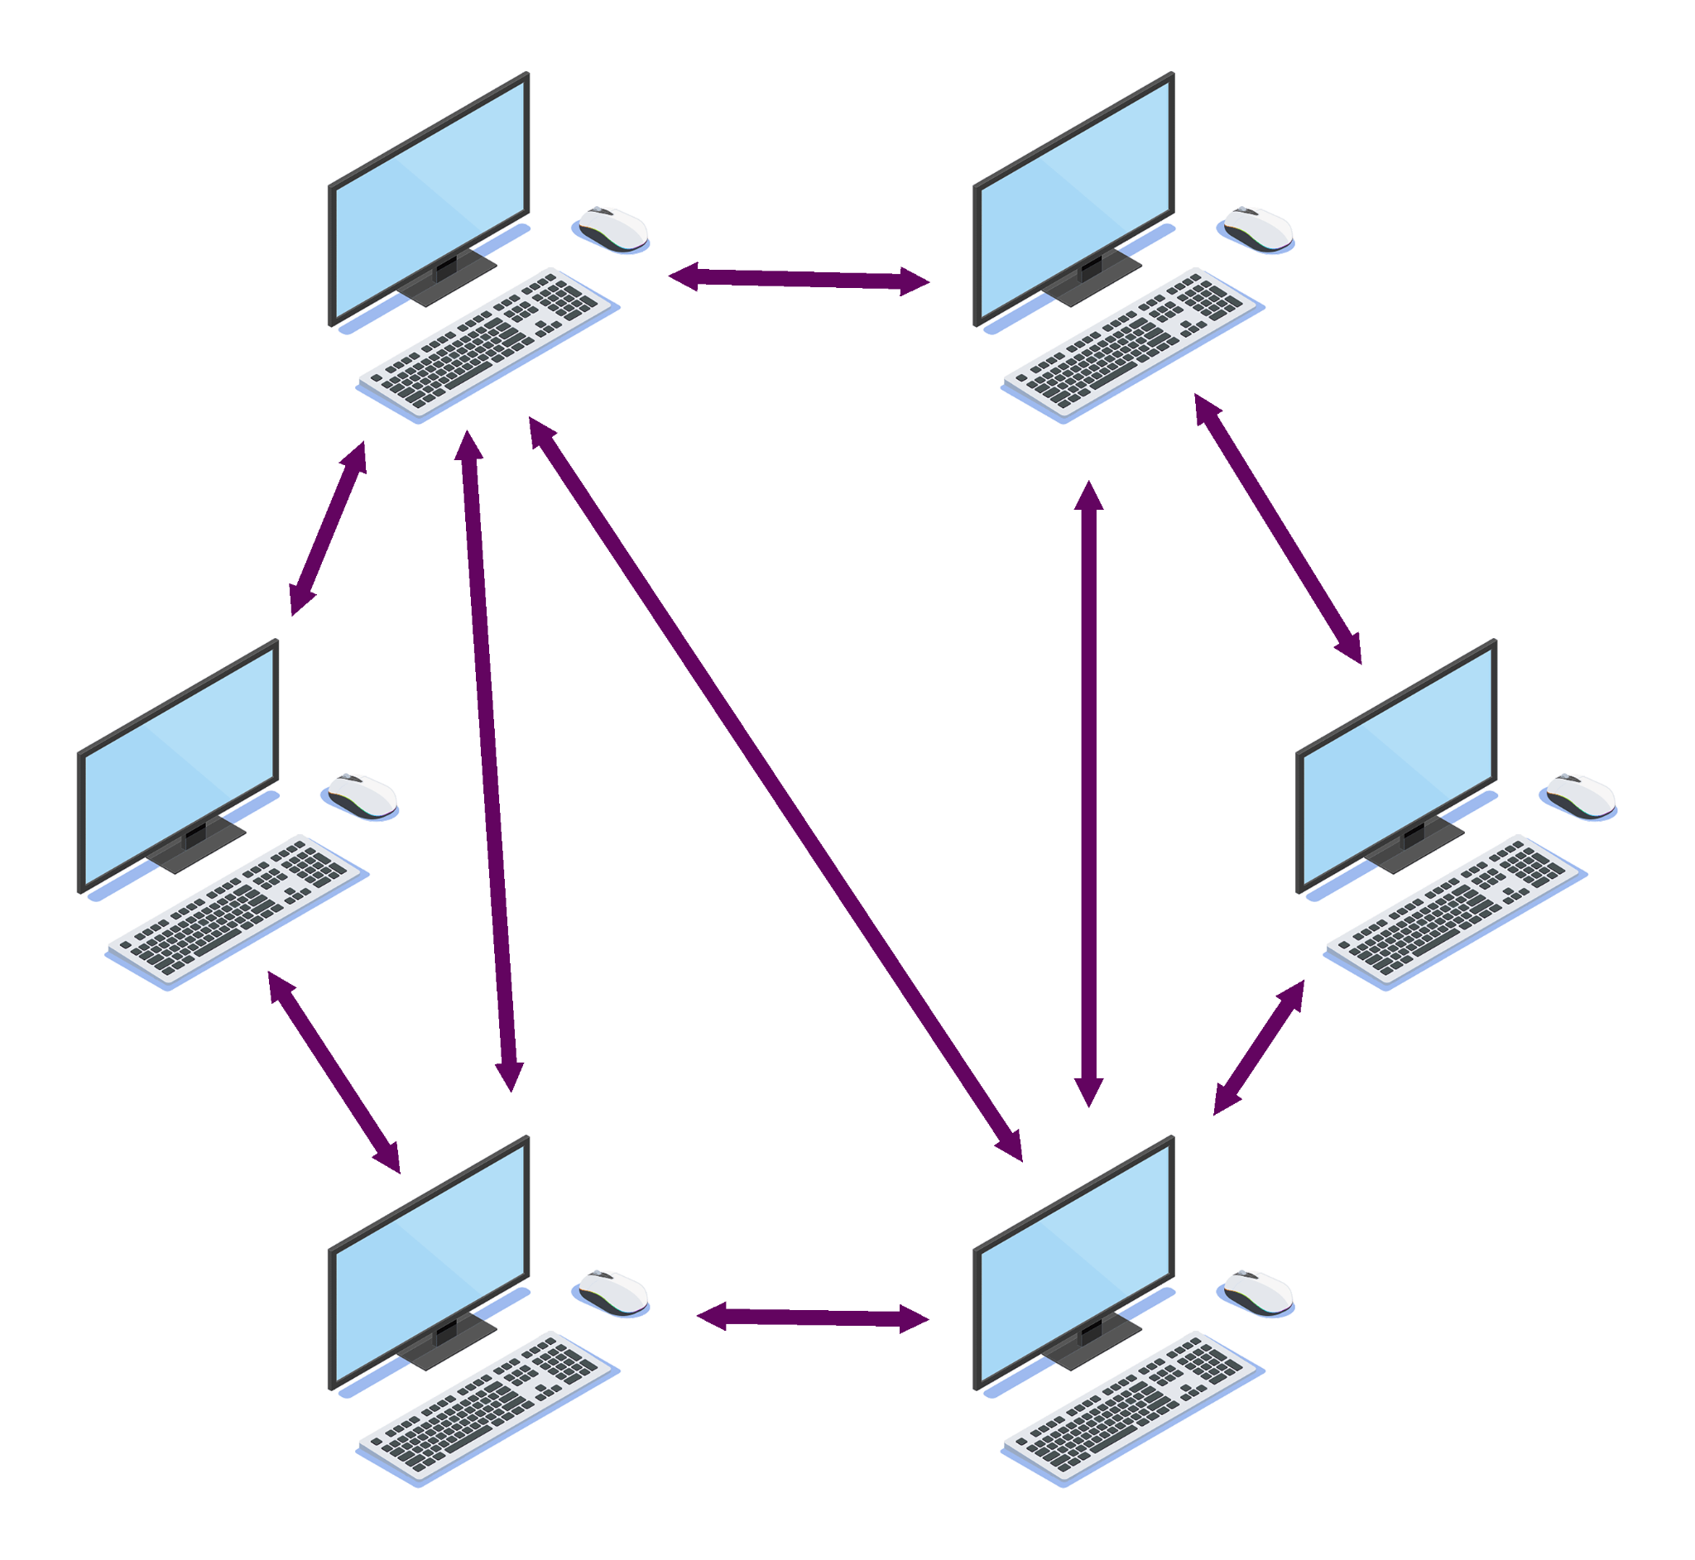
> Feature 1: Live Sharing _
Web-sockets (socket.io)
Transfer information between P2P without needing an additional resources.
Users are able to clearly identify the changes as it happens.
Visually differentiate between current changes vs no changes.
Notes:
Shishir

Slide 3
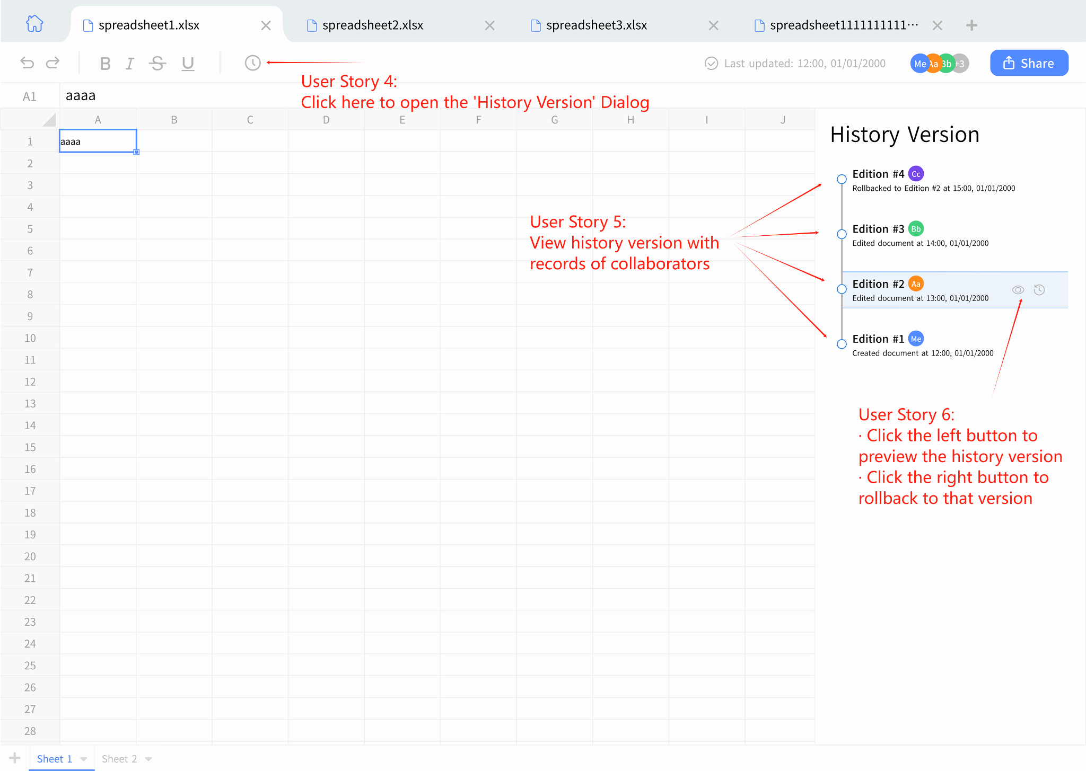
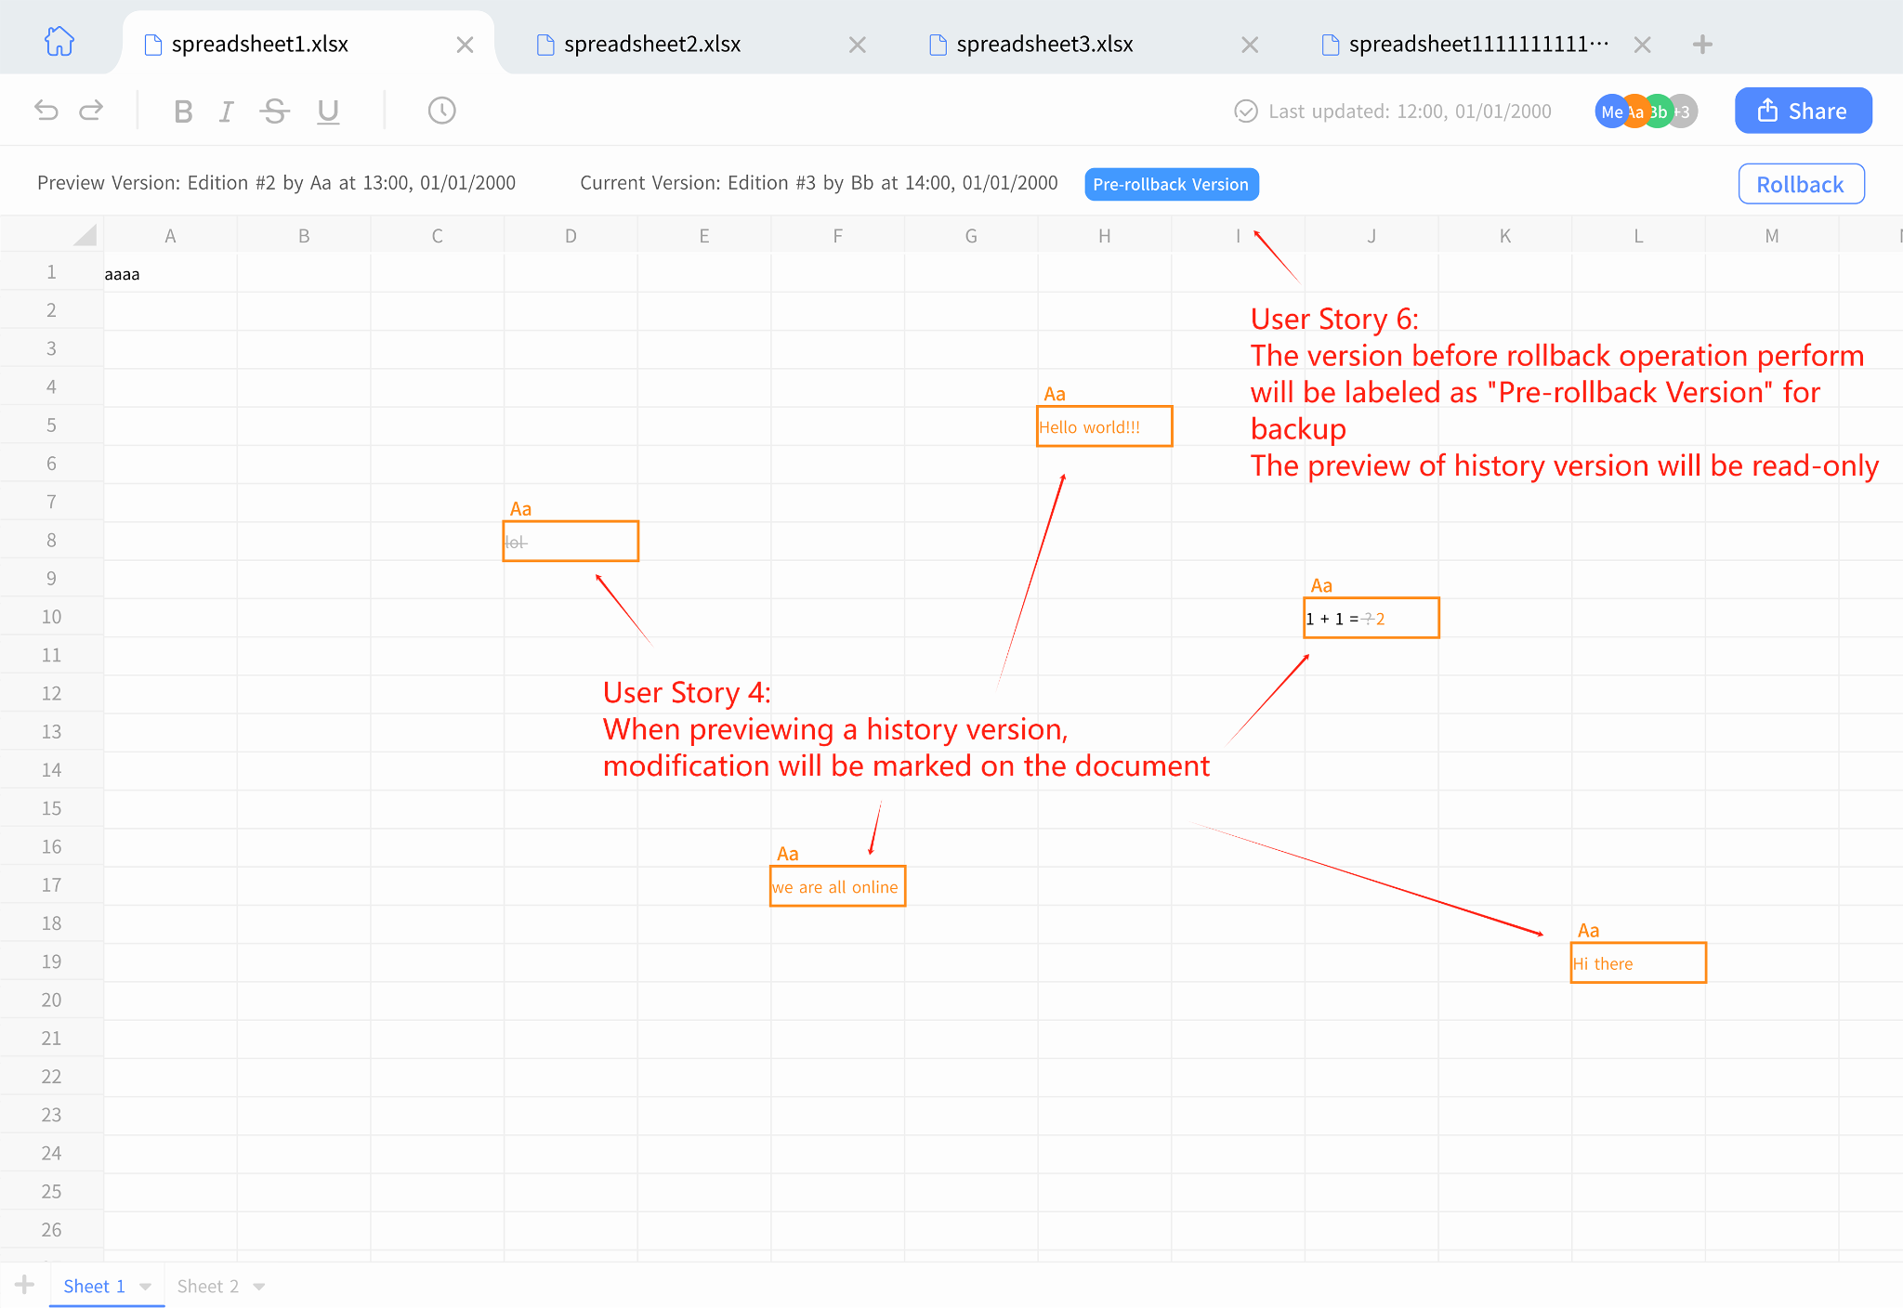

> Feature 2: Version Control _
Save and commit versions of the spreadsheet
Able to roll back to the previous versions
Users should be able to interact with older spreadsheet if they choose to roll back
Notes:
Shishir

Slide 4
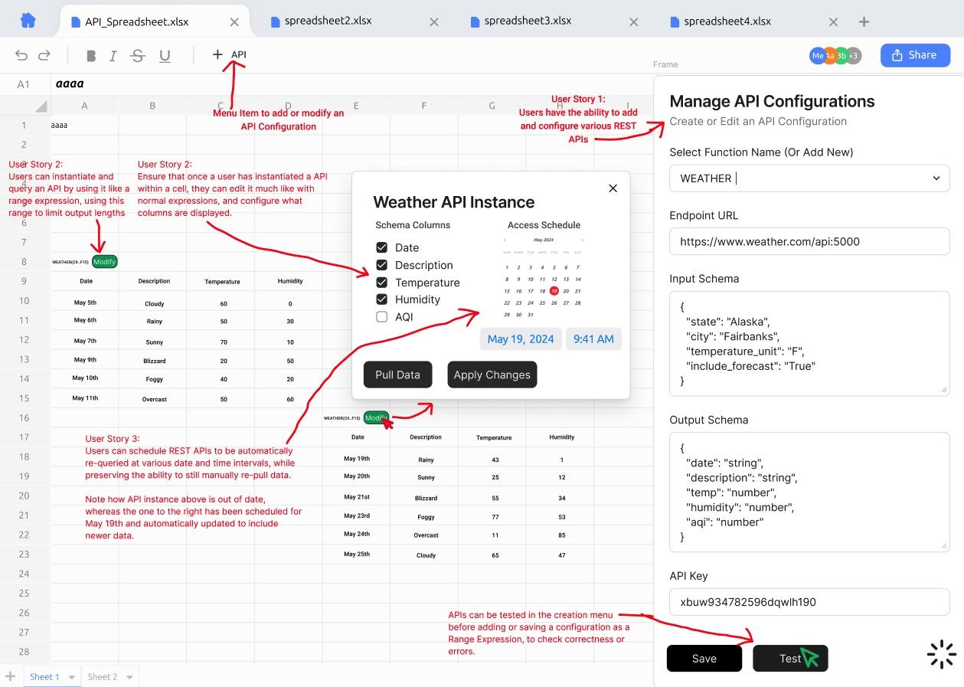
> Feature 3: Querying RESTful API _
Allow users to query REST APIs, and populate the spreadsheet with this data
Configure the following
Endpoints
API Keys and Keyword Args
Filters and Scheduled Querying
Users should be able to call APIs similar to a Range Expression
Notes:
Ganesh

Slide 5



> Progress _
Frontend
UI Design (70%)
RESTful (30%)
Backend
RESTful (56%)
Web Socket (10%)
API Querying (40%)
Database Design (70%)
Model Design (70%)
Notes:
Aofei

Slide 6

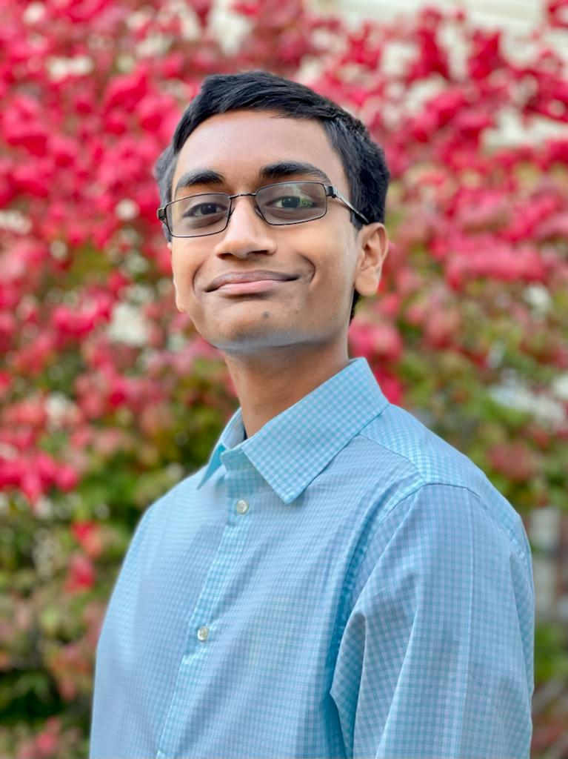
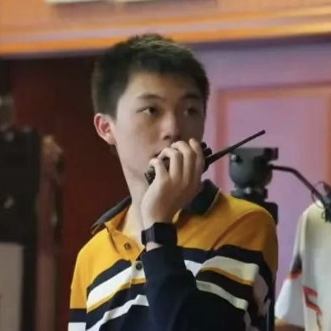
> Team Member _
Ganesh
CI Integration
Backend Model Implementation
REST API Querying Implementation
Yuzhou
UI Prototype Framework
Backend Design
DB Models Design
RESTful API Implementation

Slide 7
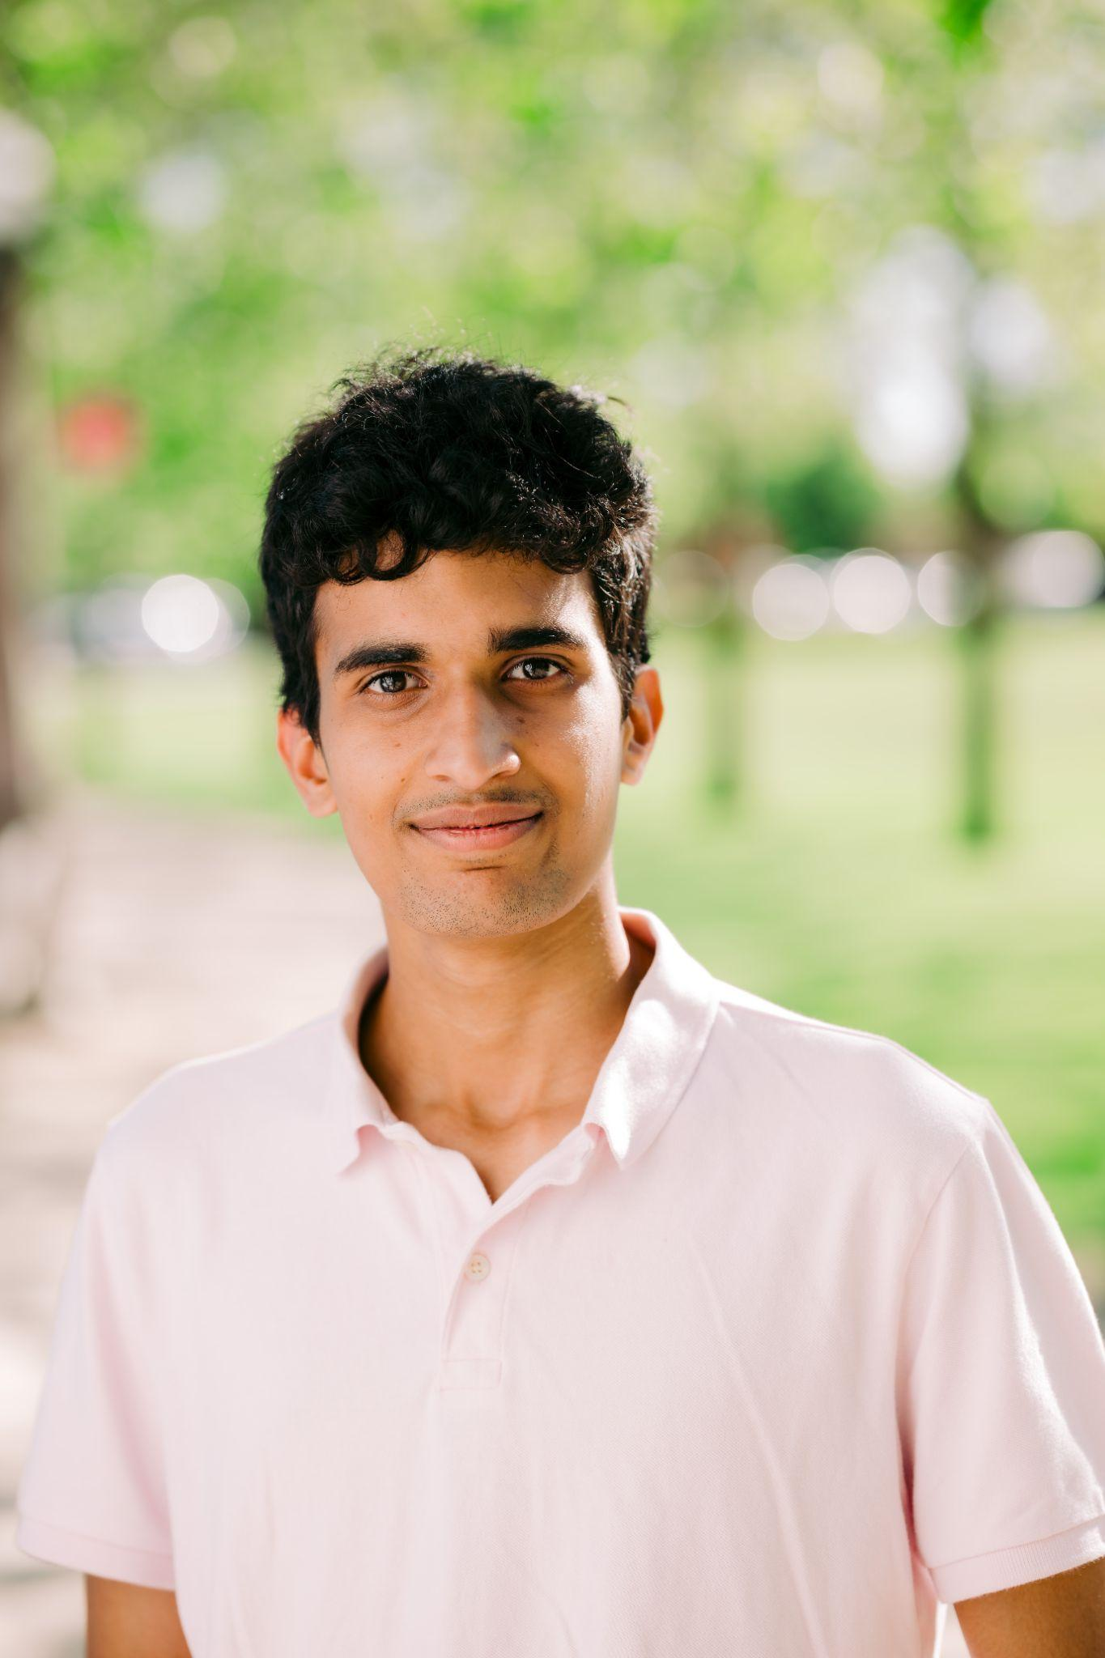
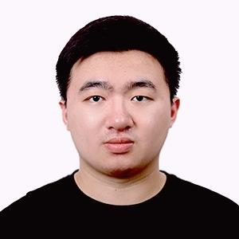
Shishir
Setting up the server to host the database.
Worked on Login (Mongo database)
Sockets for live sharing
Aofei
Setting up React Frontend
Implementing design from UMLs, with mock capabilities
Initial UI Testing

Slide 8





> Backend _
User System
Share
etc
RESTful API
(Express.js)
User
Browser
Mongo DB
Real-time Collaboration
Live update
Web Socket
(Socket.IO)
Notes:
Yuzhou

Slide 9

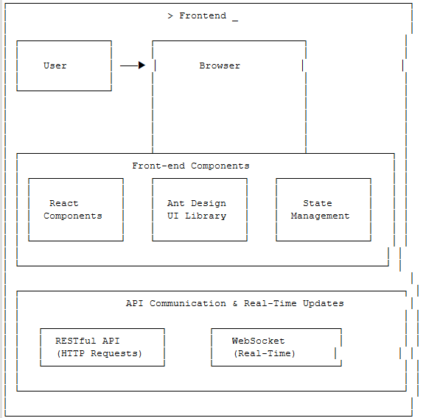


> Frontend _
Ant Design
Babel
Jest
Notes:
Aofi

Slide 10
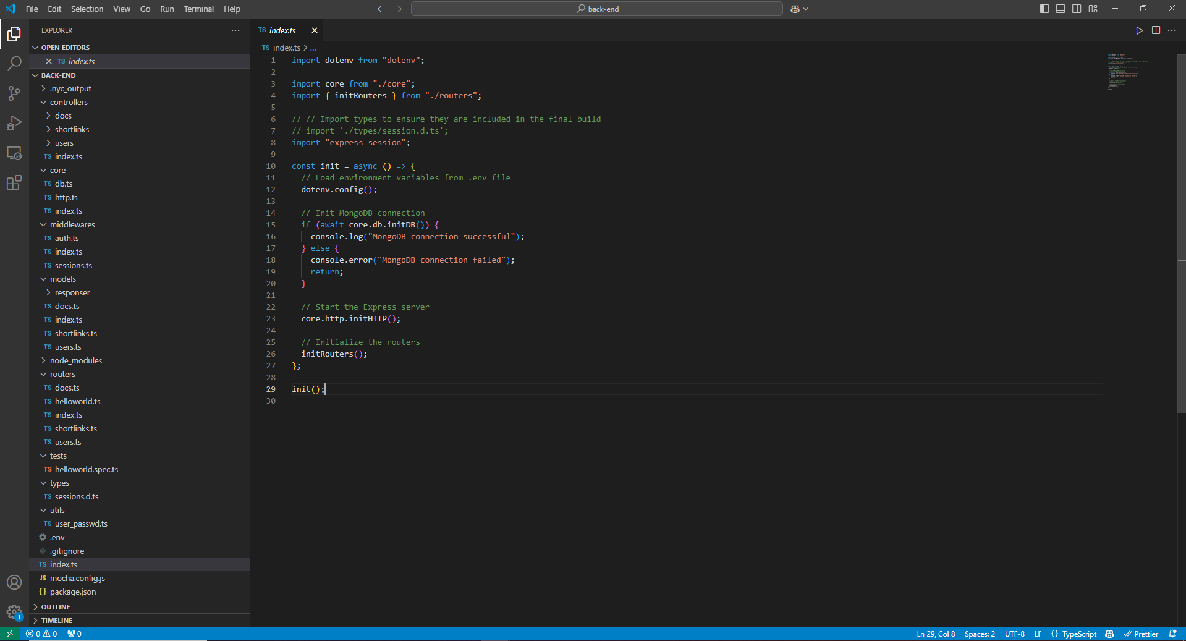
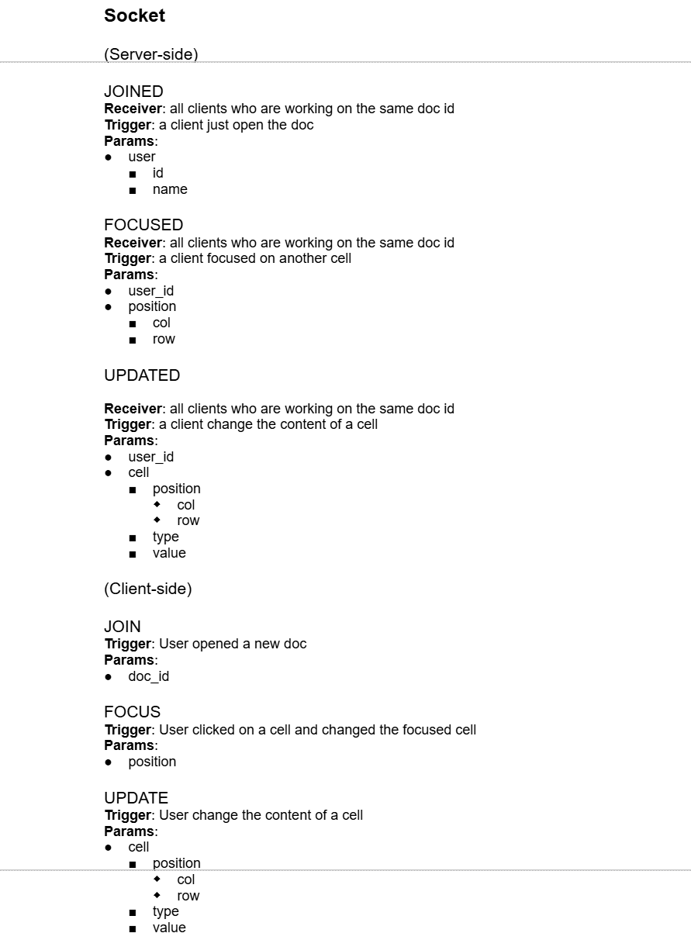
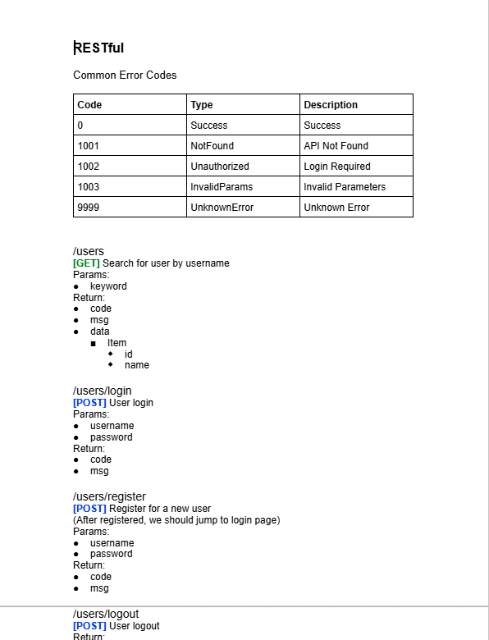
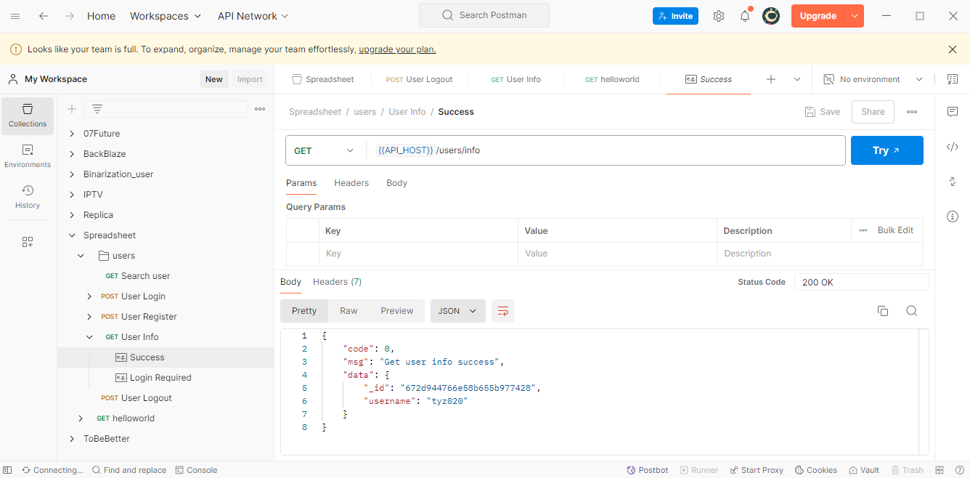
> Backend _
Notes:
Yuzhou

Slide 11
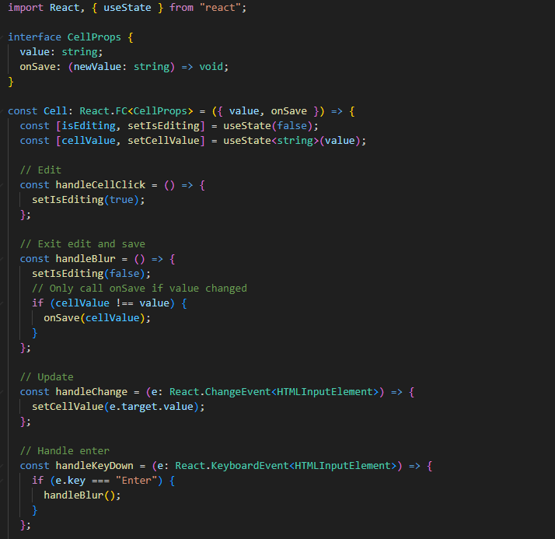
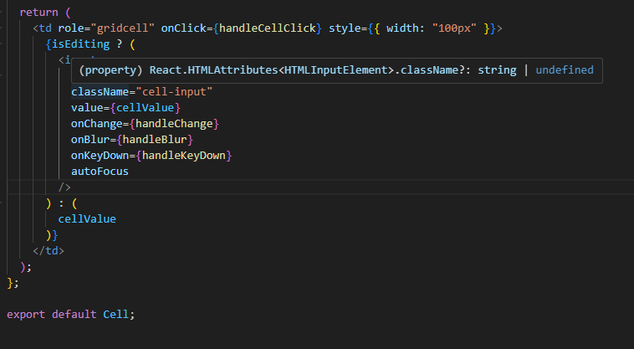
> Frontend
Notes:
Aofi

Slide 12
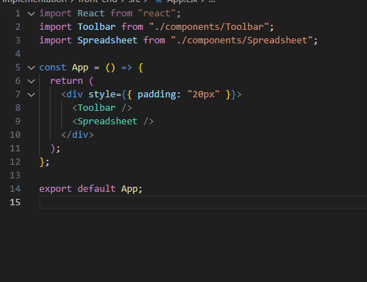
> Frontend

Slide 13
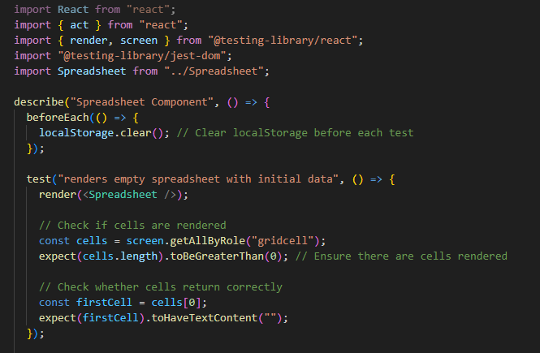
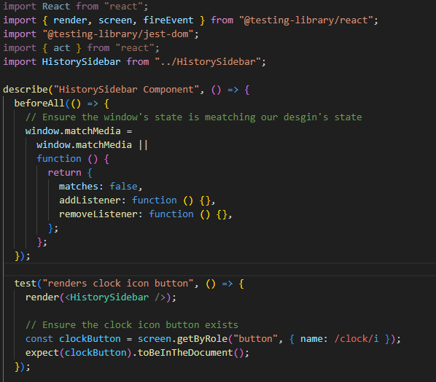
> Frontend

Slide 14
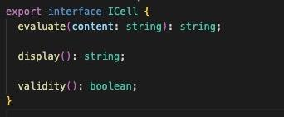
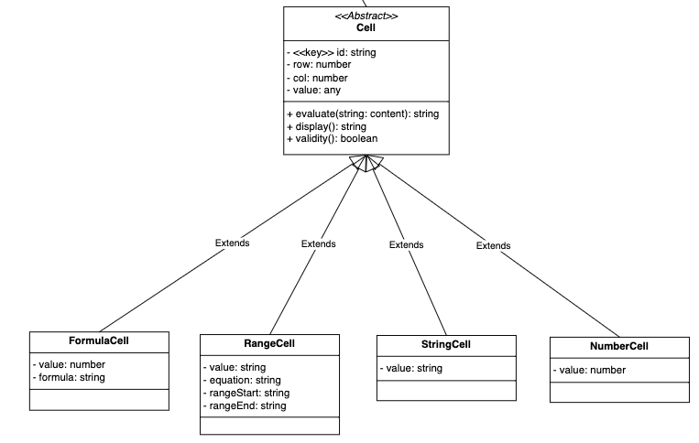
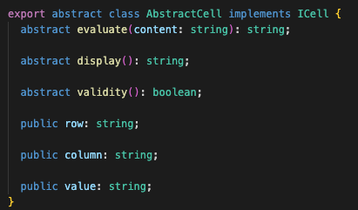
> Model

Slide 15
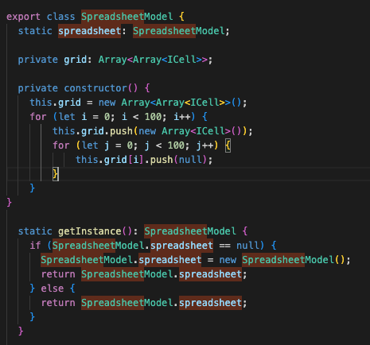
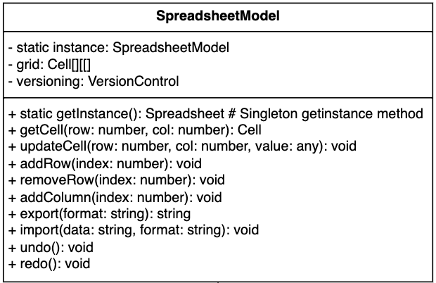
> Model

Slide 16
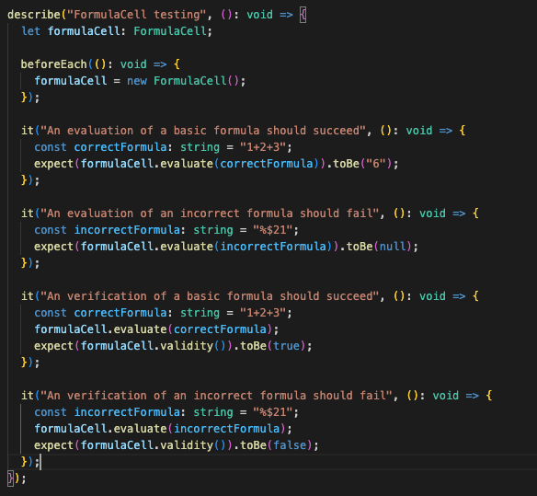
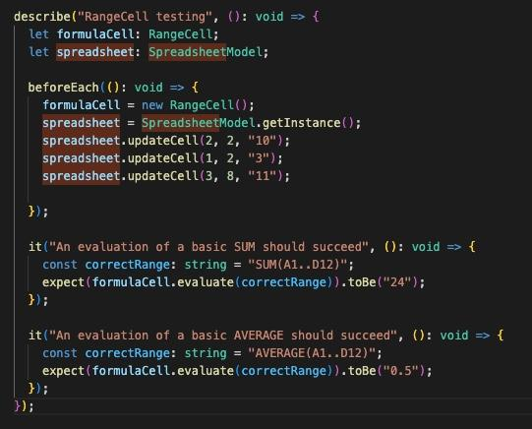
> Model

Slide 17
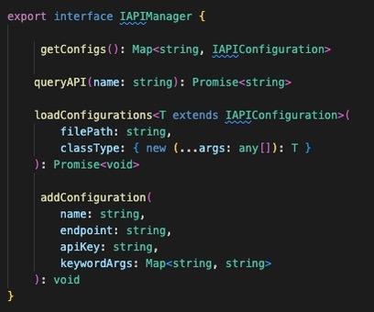
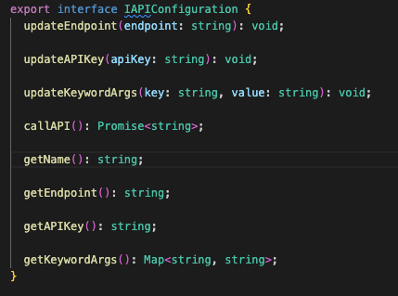

> API Querying

Slide 18
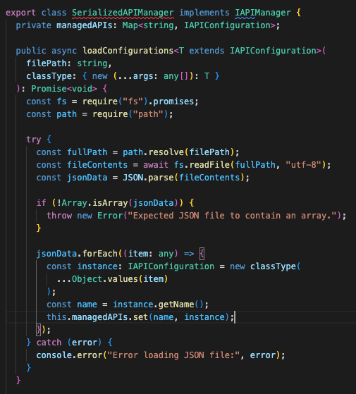
> API Querying

Slide 19
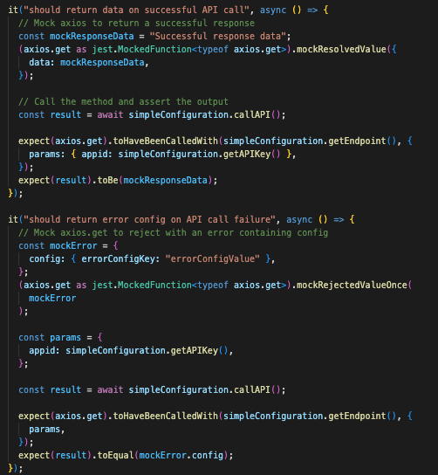
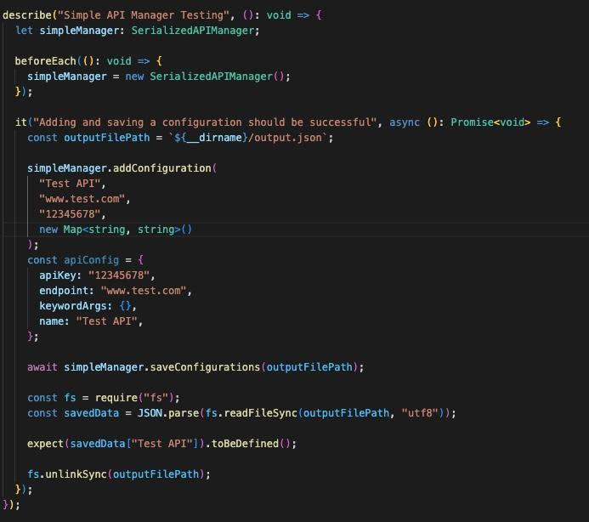
> API Querying

Slide 20


> Future Plan _
Front-end to Back-end Integration
Socket connections
Vertical Slice Testing
Notes:
Shishir

Slide 21

Connect frontend events to backend
Integrate API Querying in UI
Finish up “basic” features
Refine Backend
Start & finish websocket for live sharing
Integrate VC Database
Full Integration Testing, Revisions
Notes:
Everyone

